Slide 1
Craft predictable web apps with F#
Kevin Avignon
Kavignon @ GitHub & Twitter

Slide 2
Clients want the best product delivered quickly

Slide 3
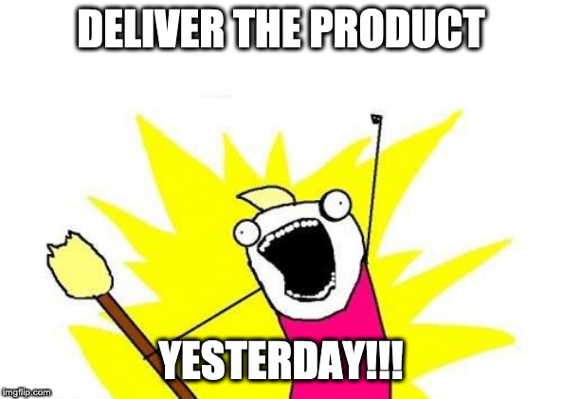

Slide 8

Plan of the evening
What is domain modeling?
Representing store products with F#
Emulate business requirements in the domain
Simulate store browsing with Fable & Elmish

Slide 9
My backstory

Slide 10
Software developer Hypertherm Robotics Software
Career focused on .NET
Web, Desktop & Tools
An enthusiast of functional programming and .NET
Discovered F# in 2016
Incorporated F# at work and we now have 3 production tools
Blogging on tech @ www.kevinavignon.com
Notes:
Genetec
Capstone project
Introducing F# at work
Great F# community
Great F# projects at work

Slide 11
Why should you listen to what I have to say today?

Slide 12
Reasons to be here today
You’ve never heard of F# before and you’re intrigued
Javascript gives you nightmares and you want to stop using it
Full-stack development is hard and you’re looking for ways to make it easier
You’d like to catch bugs earlier in your development

Slide 13
What is domain modelling?

Slide 14
Why use it?
Meaningful representation of concepts needed to be replicated by software
Giving both experts and developers a shared mental model
Making requirements explicit in the system

Slide 15
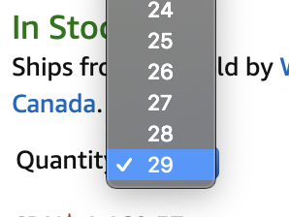
Setting it up
Focus on the inputs and outputs in the real-world
Capture both requirements and potential min/max
Avoid thinking of low-level designs too early

Slide 16
Divide & Conquer - Bounded Context
Smaller domains representing portions of the problem space
Clear boundaries to avoid coupling from problem space
Contexts should be autonomous
Must have a way to communicate with each other if needed
Notes:
Not always a 1:1 mapping from problem to solution space
Make sure boundaries don’t creep
Listen to your domain experts
Document concepts and vocabulary of the context
Emphasis on autonomy for the contexts
Capturing business logic more intuitively

Slide 17
Data Transfer Object vs Domain objects
Domain objects: Objects defined inside the bounded context
Data transfer object (DTO): Only used for serialization and communication between bounded contexts

Slide 18
Commands, Domain Events & Workflows
Command (Input): Data object sent to the domain to request a change
Event (Output): Abstraction of the changes that occurred inside the domain
Workflow
Process triggered by a command
Outputs a set of domain events

Slide 19
Now we know domain modeling.
What about functional programming?

Slide 20
FP vs OO approaches in hindsight
 | OO | FP
Handling state | Allowing mutation | No mutation
Building blocks | Classes and objects | Functions
Reduced coupling | Interfaces, abstract classes & dependency injection | Functions
Code reuse | Inheritance | Function composition
Program actions | Statements | Expressions

Slide 21
Functions
Pure | Impure
Side-effect free | Depends
Same input = same output | Depends
Easy to compose | Depends
Easy to test | Hard to test

Slide 22

C# Programmers of today use some functional concepts

Slide 23
Some functional concepts in C#
Strings
Once set, their values don’t change
Getter-only auto-properties
LINQ
Tuples

Slide 24
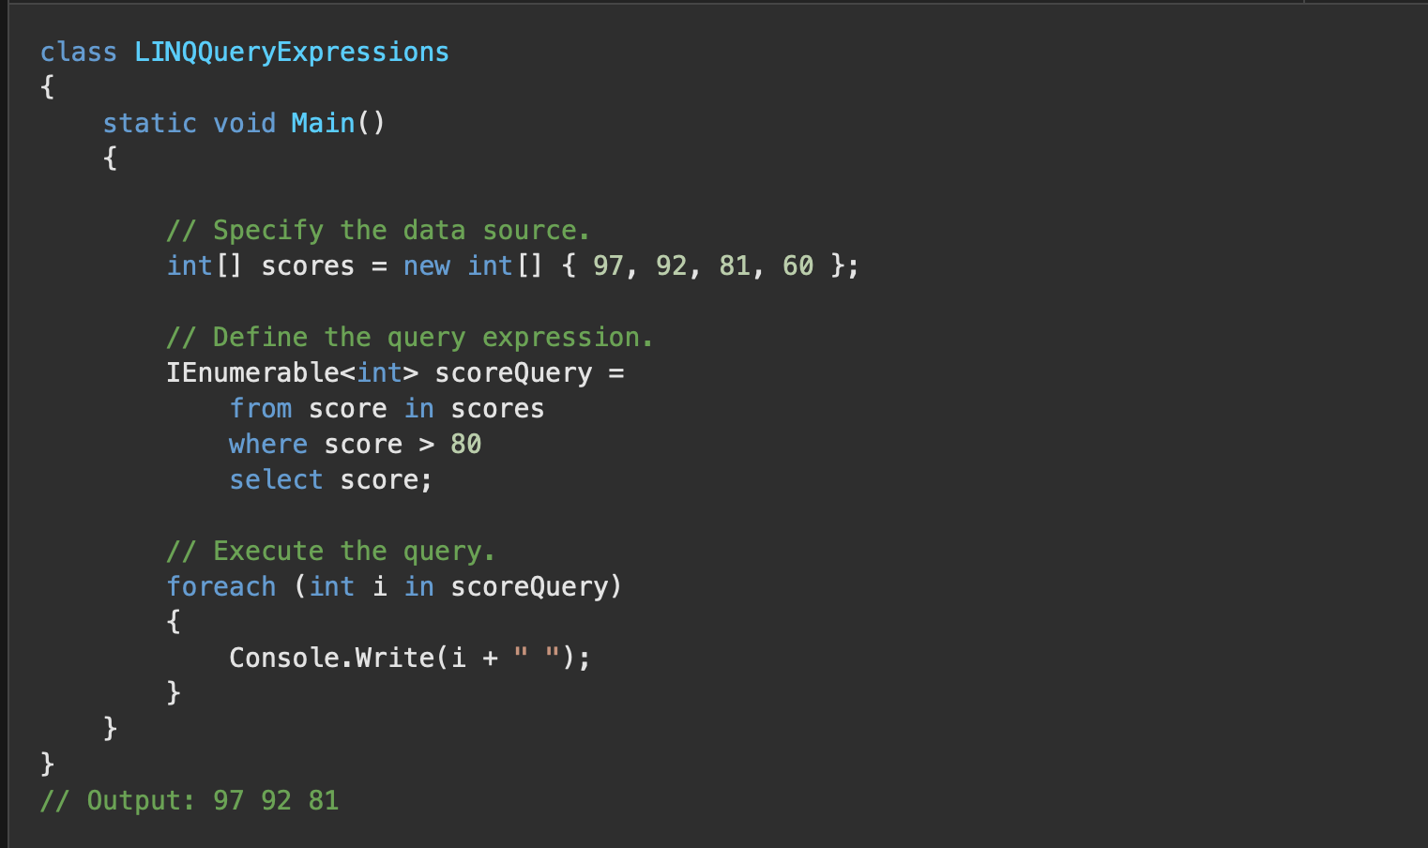

Slide 25
Immutability by default
Nothing changes after the data has been set
You have 100% control on data updates
No more obscure unwanted mutation at runtime

Slide 26
If C# already supports functional programming,
why bother learning a new language for .NET?

Slide 27
1. Picking the right tools for the job

Slide 28
Law of the instrument
C# is really good for OO software projects
C# wasn’t created with functional programming in mind
Functions are second-citizen
Mutation is by default
Syntax is pretty verbose

Slide 29
I suppose it is tempting, if the only tool you have is a hammer, to treat everything as if it were a nail
- Abraham Maslow

Slide 30
2. Testimonials from companies

Slide 31
Gamesys Testimonial
They’ve observed an increase in productivity
Allowed one developer to replace an entire Java team
Rules engine for social slot games served 700,000 unique players and 150,000,000 requests per day

Slide 32
Bayad Rock Testimonial
“F# succinctness allowed to rapidly iterate on new ideas”
“The type system acted as a safety net”
“F# has given us a great advantage over slower competitors”
“3 years in and our products are getting significantly better without sacrificing stability”

Slide 33
3. Embraced by big players

Slide 34
List of companies using F# - https://github.com/Kavignon/fsharp-companies

Slide 35
4. Predictable behaviour

Slide 36
Anticipated inner workings
Values must be initialized with valid states
Comparing values of different types is a compile-time error
Values are immutable by default
Records with the same data are equal by default

Slide 37
Case Study: Building an e-commerce web application

Slide 38
Representing store products

Slide 39
Laptop

Slide 40
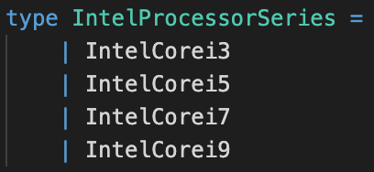
Discriminated Union

Slide 41
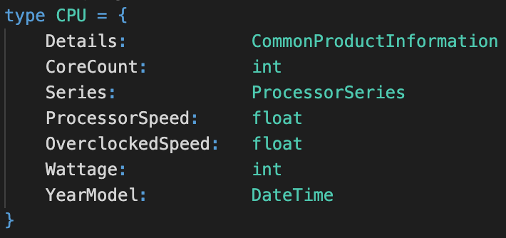
Record

Slide 42
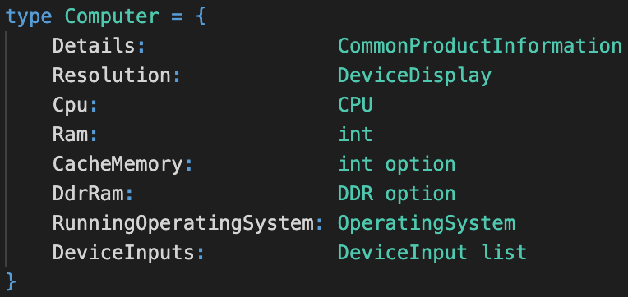
Optional values instead of nulls

Slide 43
Type inference
Automatic detection of your data type
Makes the code more concise

Slide 44
Representing Store Products

Slide 45
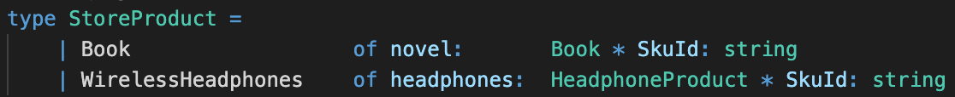

Slide 46
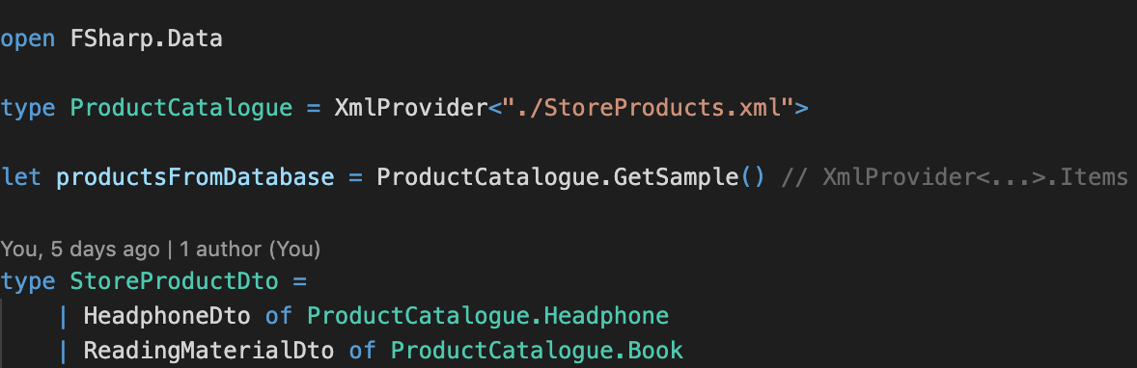
Type Provider (XML)

Slide 47
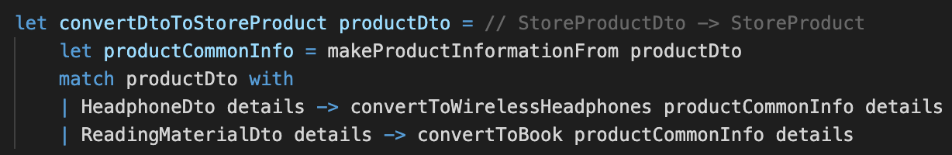
Pattern matching

Slide 48
Pipe operators (forward)

Slide 49
15 minutes break

Slide 50
Business Requirements
Authenticated users can add products to their shopping cart.
Authenticated users can remove products from their shopping cart.
Authenticated users can consult their previous orders.
An authenticated user can update their payment method from his account.
A successful order will be confirmed will an automatic email with the order summary.

Slide 51
Designing with types
Represent your domain entities and actions with
Discriminated unions
Records
Function signatures

Slide 52
Reasons behind type driven development
Business logic can be complicated
Logic abstracted through types is self-documenting

Slide 53
Example:
I want to add two copies of a book to the cart
Example:
Sending an acknowledgement to a customer’s email
Format email based on culture
Spanish (Spain)
English (Canada)
Only when the order has been validated

Slide 54
Emulating browsing of store products with F#

Slide 55
What is
?
F# application development stack for web development
Made of 4 components
A .NET Core web server [S]
A hosting platform (i.e. Azure) [A]
A mechanism to run F# client code inside the browser [F]
An F# model to develop client-side UIs [E]

Slide 56
Why is it interesting for a .NET dev?
Type safe programming from back-end to front-end with F#
Allows code sharing with back-end and front-end
No need to be an expert of CSS or Javascript

Slide 57
Many frameworks for front-end

Slide 58
A few words on
Preferred to be referred as a library, not a framework
Creating reusable UI components (i.e. forms, dropdowns, etc)
Embraces FP
Declarative programming model
Immutability is preferred

Slide 59
Do I have to use React with SAFE?
Short answer, no
React is used because of its FP-nature
You can create your own bindings to JS library/framework

Slide 60
So what’s Saturn?
Web development library for F#
Used for both web server APIs and MVC apps
Sits on top of ASP.NET Core
Hosts your client assets (HTML/CSS & Js) generated by Fable

Slide 61
F is for Fable
F# to Javascript compiler
Produces readable Javascript for browsers
Integrates with JS
Can use JS libs from F# and vice-versa
Powered by Babel
Toolchain to convert ES5 in backwards compatible Javascript

Slide 62
E as Elmish
Set of abstractions for writing user interfaces in F#
Embraces the Model-View-Update pattern made popular by Elm (FP lang)
Provides an solid UI-independent core

Slide 63
Overview of Elmish concepts
Model - Snapshot of the application’s state (immutable)
Message - Event representing a change in the app (i.e initial loading)
Command - Carrier of instructions
May results to more than 1 message
Update - Pure function new app state from the previous snapshot
View - Pure function that generates a new layout/content
Uses a rendering engine such as React’s

Slide 64
Demo

Slide 65
Recommended Resources

Slide 66
Beginner friendly F# resources
F# for C# programmers: https://www.youtube.com/watch?v=KPa8Yw_Navk
Functional Design Patterns: https://www.youtube.com/watch?v=srQt1NAHYC0
The Power of Composition: https://www.youtube.com/watch?v=vDe-4o8Uwl8
The functional programming toolkit: https://www.youtube.com/watch?v=Nrp_LZ-XGsY
Functional programming with F# series: https://www.youtube.com/playlist?list=PLEoMzSkcN8oNiJ67Hd7oRGgD1d4YBxYGC
F# for fun and profit: https://fsharpforfunandprofit.com/
F# Workshop: http://www.fsharpworkshop.com/

Slide 67
SAFE Tutorials
SAFE Dojo: https://github.com/CompositionalIT/SAFE-Dojo/
Introduction to the Elm architecture with Elmish F# and Fable: https://www.youtube.com/watch?v=3Qk4bWs7vrs
Let’s build a TODO list with React, Elmish, F# & Fable: https://www.youtube.com/watch?v=zAfW_-m1u4k
Let’s talk HTTP with React, Elmish F# & Fable: https://www.youtube.com/watch?v=_2U4pDj6tng
Hackers news clone with SAFE: https://www.youtube.com/watch?v=w0Am8fRQzGg
From F# to Javascript with Fable: https://www.youtube.com/watch?v=5191ytFmG_A

Slide 68
SAFE Resources
SAFE Stack docs: https://safe-stack.github.io/docs/
Saturn docs: https://saturnframework.org/docs/
Elmish docs: https://elmish.github.io/elmish/
SAFE Mock-Commerce: https://github.com/Kavignon/.NETDemoCode/tree/master/SAFE-Mock-Commerce
SAFE BookStore: https://github.com/SAFE-Stack/SAFE-BookStore
SAFE Chat: https://github.com/SAFE-Stack/SAFE-Chat
SAFE Search: https://github.com/SAFE-Stack/SAFE-Search
Tabula Rasa - Minimalist blog engine: https://github.com/Zaid-Ajaj/tabula-rasa

Slide 69
SAFE Tools Resources
SAFE Template - Basic template to get started: https://github.com/SAFE-Stack/SAFE-template
Fable.Remoting - type safe communication layer between client & server: https://github.com/Zaid-Ajaj/Fable.Remoting
Femto - CLI tool to resolve npm/yarn packages: https://github.com/Zaid-Ajaj/Femto
Feliz - DSL for React development in F#: https://github.com/Zaid-Ajaj/Feliz
Feliz.Router - Elmish router with Feliz: https://github.com/Zaid-Ajaj/Feliz.Router
Feliz.MaterialUI - Fable bindings with Feliz DSL to MaterialUI: https://github.com/cmeeren/Feliz.MaterialUI

Slide 70
Learning React Resources
Intro to React: https://reactjs.org/tutorial/tutorial.html
Introduction to React and Intermediate React: https://btholt.github.io/complete-intro-to-react-v5/

Slide 71


Slide 72
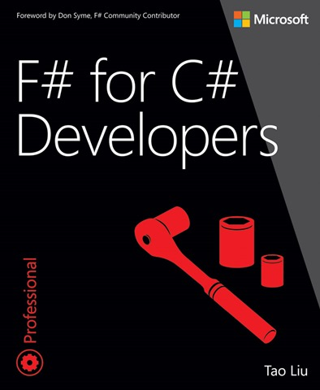

Slide 73
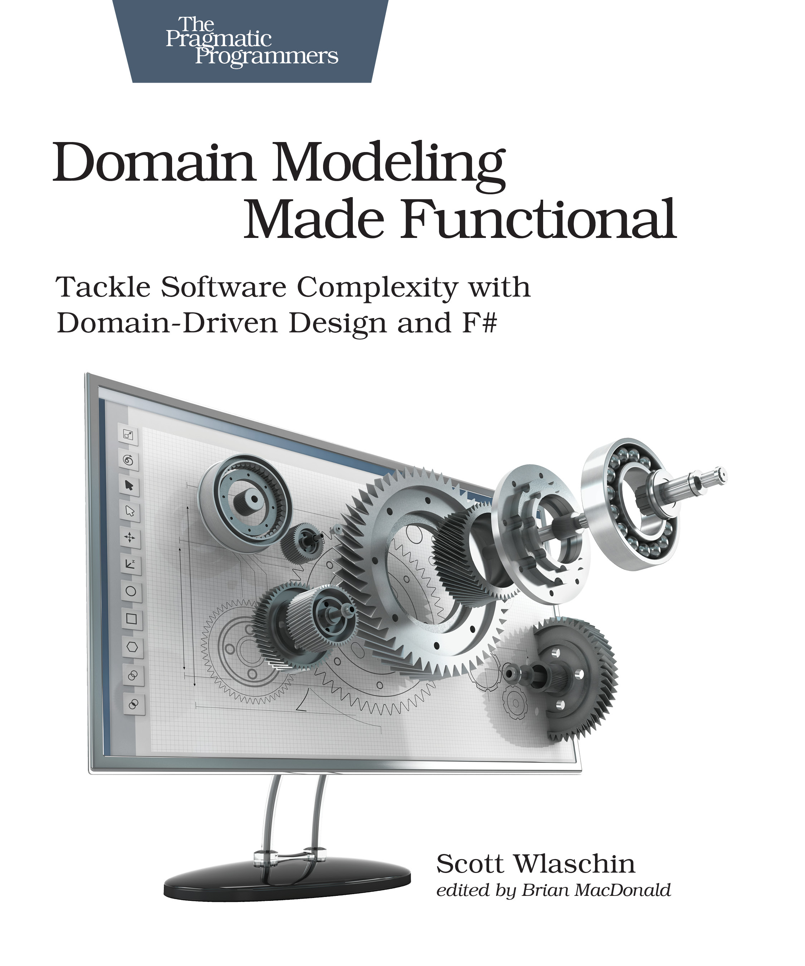

Slide 74
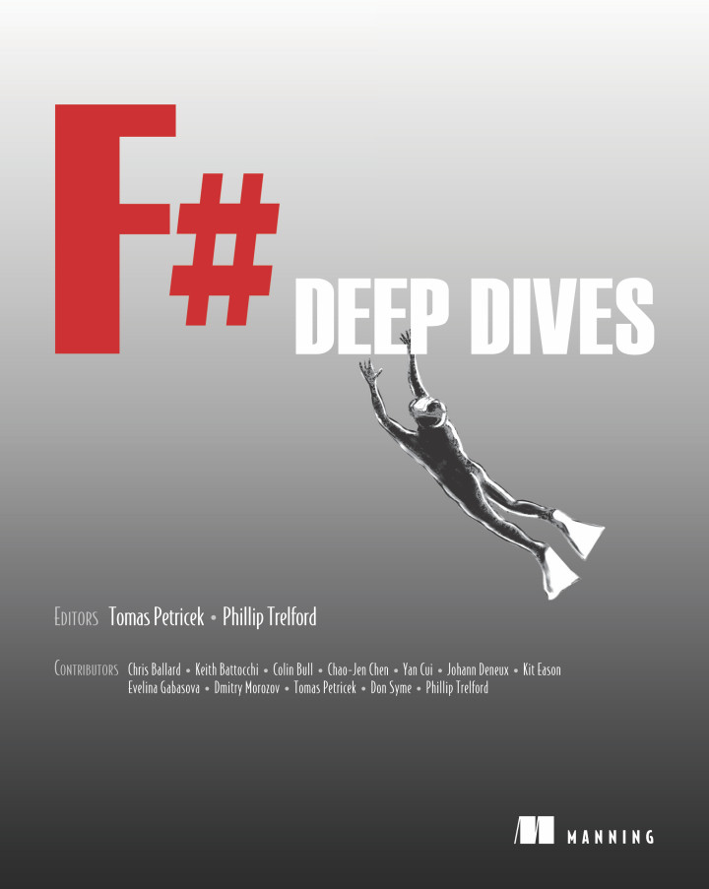

Slide 75
Any questions?

